Slide 1
Method of Hyperparameter Optimization of a Genetic Algorithm applied in Critical Scenario Generation for Autonomous Vehicles Master‘s Thesis Presentation

Slide 2
Introduction
Testing the functionality of autonomous driving systems is crucial to ensure road safety
Critical traffic scenarios are generated to validate these systems
Implementation:
Autonomous driving functionality is applied on the EGO vehicle
The Cumulated Emergency Brake Duration is the chosen criticality measure of a traffic scenario
Genetic Algorithm optimizes the Cumulated Emergency Brake Duration of the EGO vehicle
controls all other vehicles (NPCs) in the simulation

Slide 3
Research Questions
Q1: Is a genetic algorithm suitable for generating critical driving scenarios compared to random search?
Q2: Can the performance of a genetic algorithm be improved by optimizing the control parameter using the Taguchi method?

Slide 4
Simulation Setup
Traffic Manger provides a traffic simulation
Vehicles and pedestrians move through the simulation in a realistic manner
Provides an interface to alter individual actor behaviour through actions
Example actions: LaneChange, JunctionSelection, ModifyTargetVelocity, CrossRoad, etc …
Genetic Algorithm optimizes the fitness function by directing NPCs through actions
Traffic Manger
Genetic Algorithm
Cost
Action Interface
NPC 1
NPC 2
NPC 3
…

Slide 5
Genetic Algorithm Overview
Search algorithm inspired by the process of natural selection
Can efficiently navigate large search spaces
Population-Based Optimization:
Operates on a population of potential solutions (i.e., individuals)
Solutions evolve over multiple generations
Fitness function guides the selection of better individuals
Utilizes crossover and mutation as genetic operators for reproduction
Chromosome:
Consist of a list of genes and form a solution to the search problem
Custom encodings are required
Two different encodings were designed and compared
Both encodings contain the actions for all NPCs for a whole simulation

Slide 6
Hyperparameter Tuning
Literature review
Recommended hyperparameter combinations gathered from existing literature
32 different hyperparameter combinations tested over 5 repetitions
Taguchi Method
Required 16 experiment runs over 8 repetitions
Optimized:
Three 4-level factors
Four 2-level factors
One interaction

Slide 7
Hyperparameter Tuning – Taguchi Method
Developed by Genichi Taguchi for robust optimization
Part of Design of Experiment
Systematic approach for process optimization
Identifies factors (i.e., hyperparameters) impacting performance using ANOVA
Identifies optimal factor-level (i.e., setting for each hyperparameter) combination
Advantages of Taguchi Method:
Robustness, Cost-Efficiency, Simplicity
Orthogonal Arrays:
Each factor is varied at different levels across different experimental trials
Ensures that the effects of each factor and their interactions are isolated
Notes:
While there are some other aspects to the Taguchi Method, I mainly focused on orthogonal arrays

Slide 8
Genetic Algorithms Comparison
Hyperparameter Combinations
Settings | Literature Review | Taguchi Method
Number of Generations | 30 | 30
Population Size | 96 | 96
Crossover Type | Two Point | Uniform 0.5
Crossover Rate | 0.8 | 0.9
Mutation Rate | 0.2 | 0.3
Tournament Size | 4 | 4

Slide 9
Evaluation
Comparison between:
Optimized Genetic Algorithm – uses the resulting values from the Taguchi method
Default Genetic Algorithm – uses best values from the literature review
Random Search
Each algorithm was tested on
4 different start scenarios
10 repetitions per start scenario
Statistical Tools used:
T-test
Effect size

Slide 10
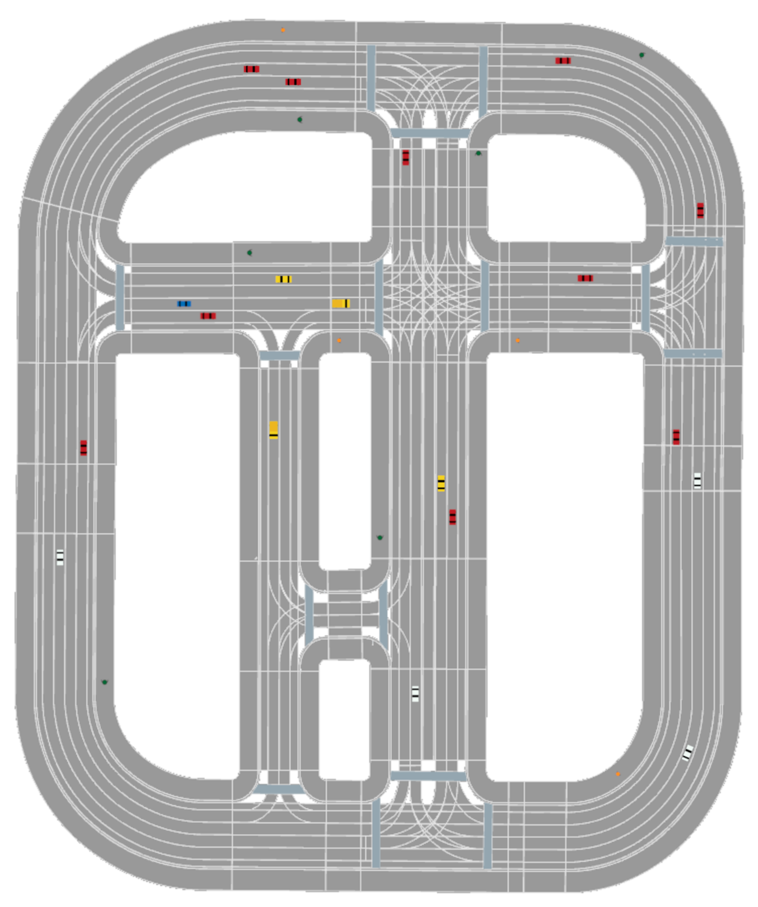
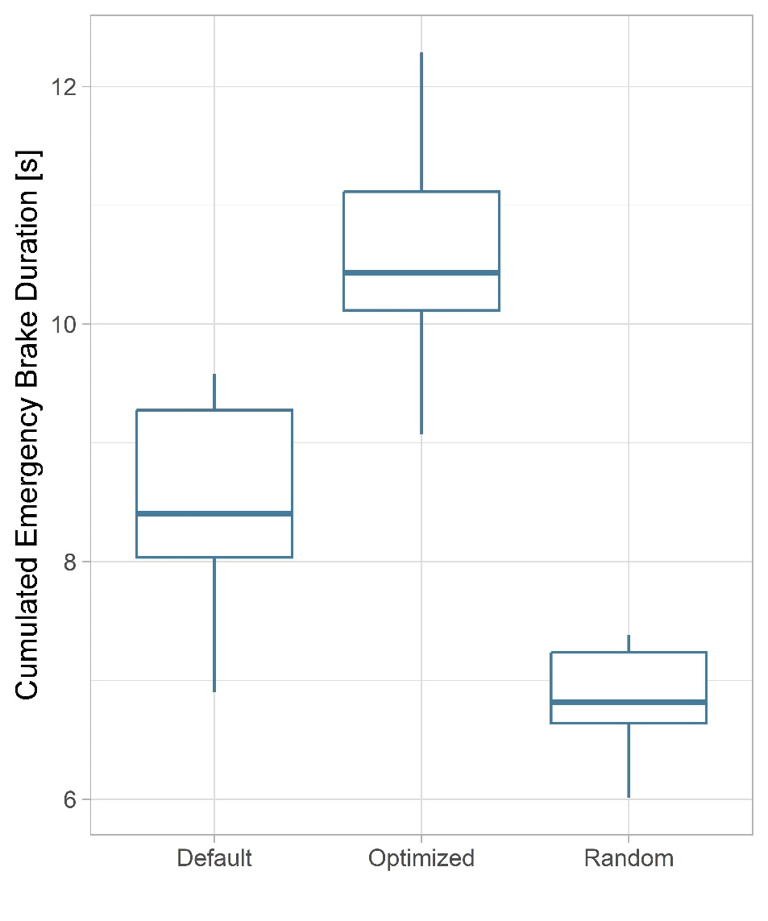
Evaluation: Start Scenario 1

Slide 11
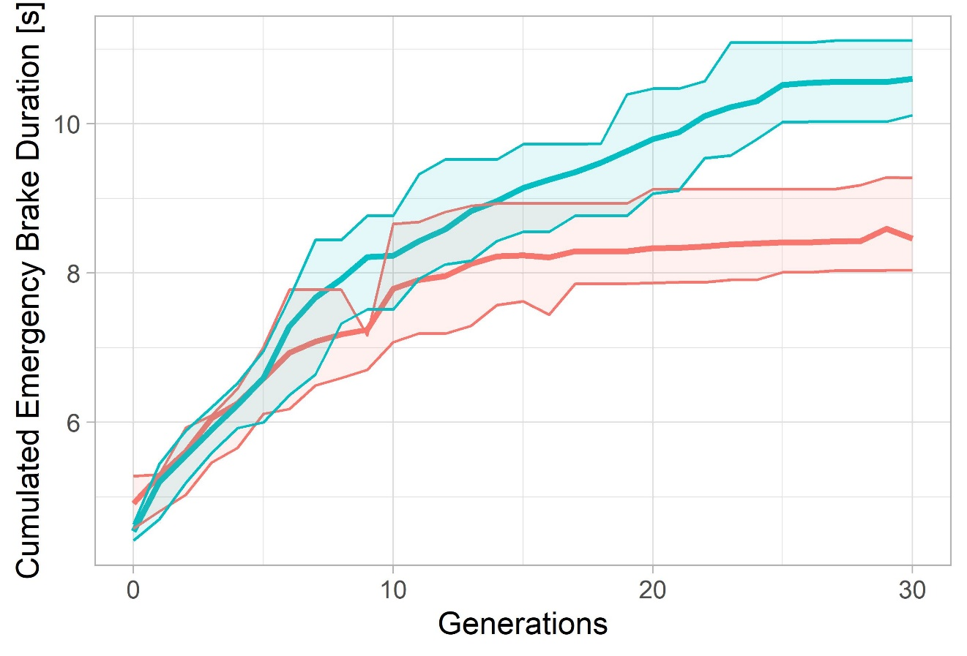
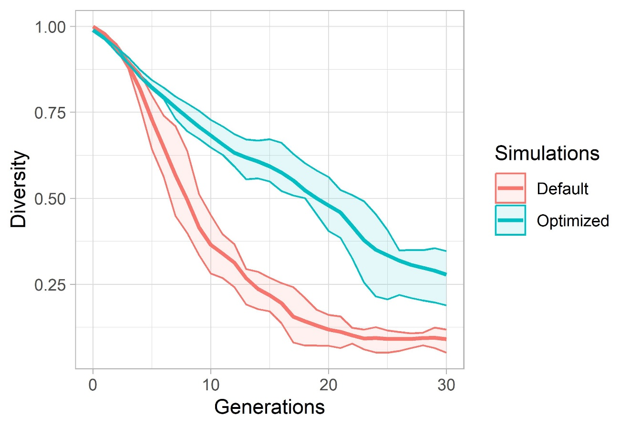
Evaluation: Start Scenario 1

Slide 12
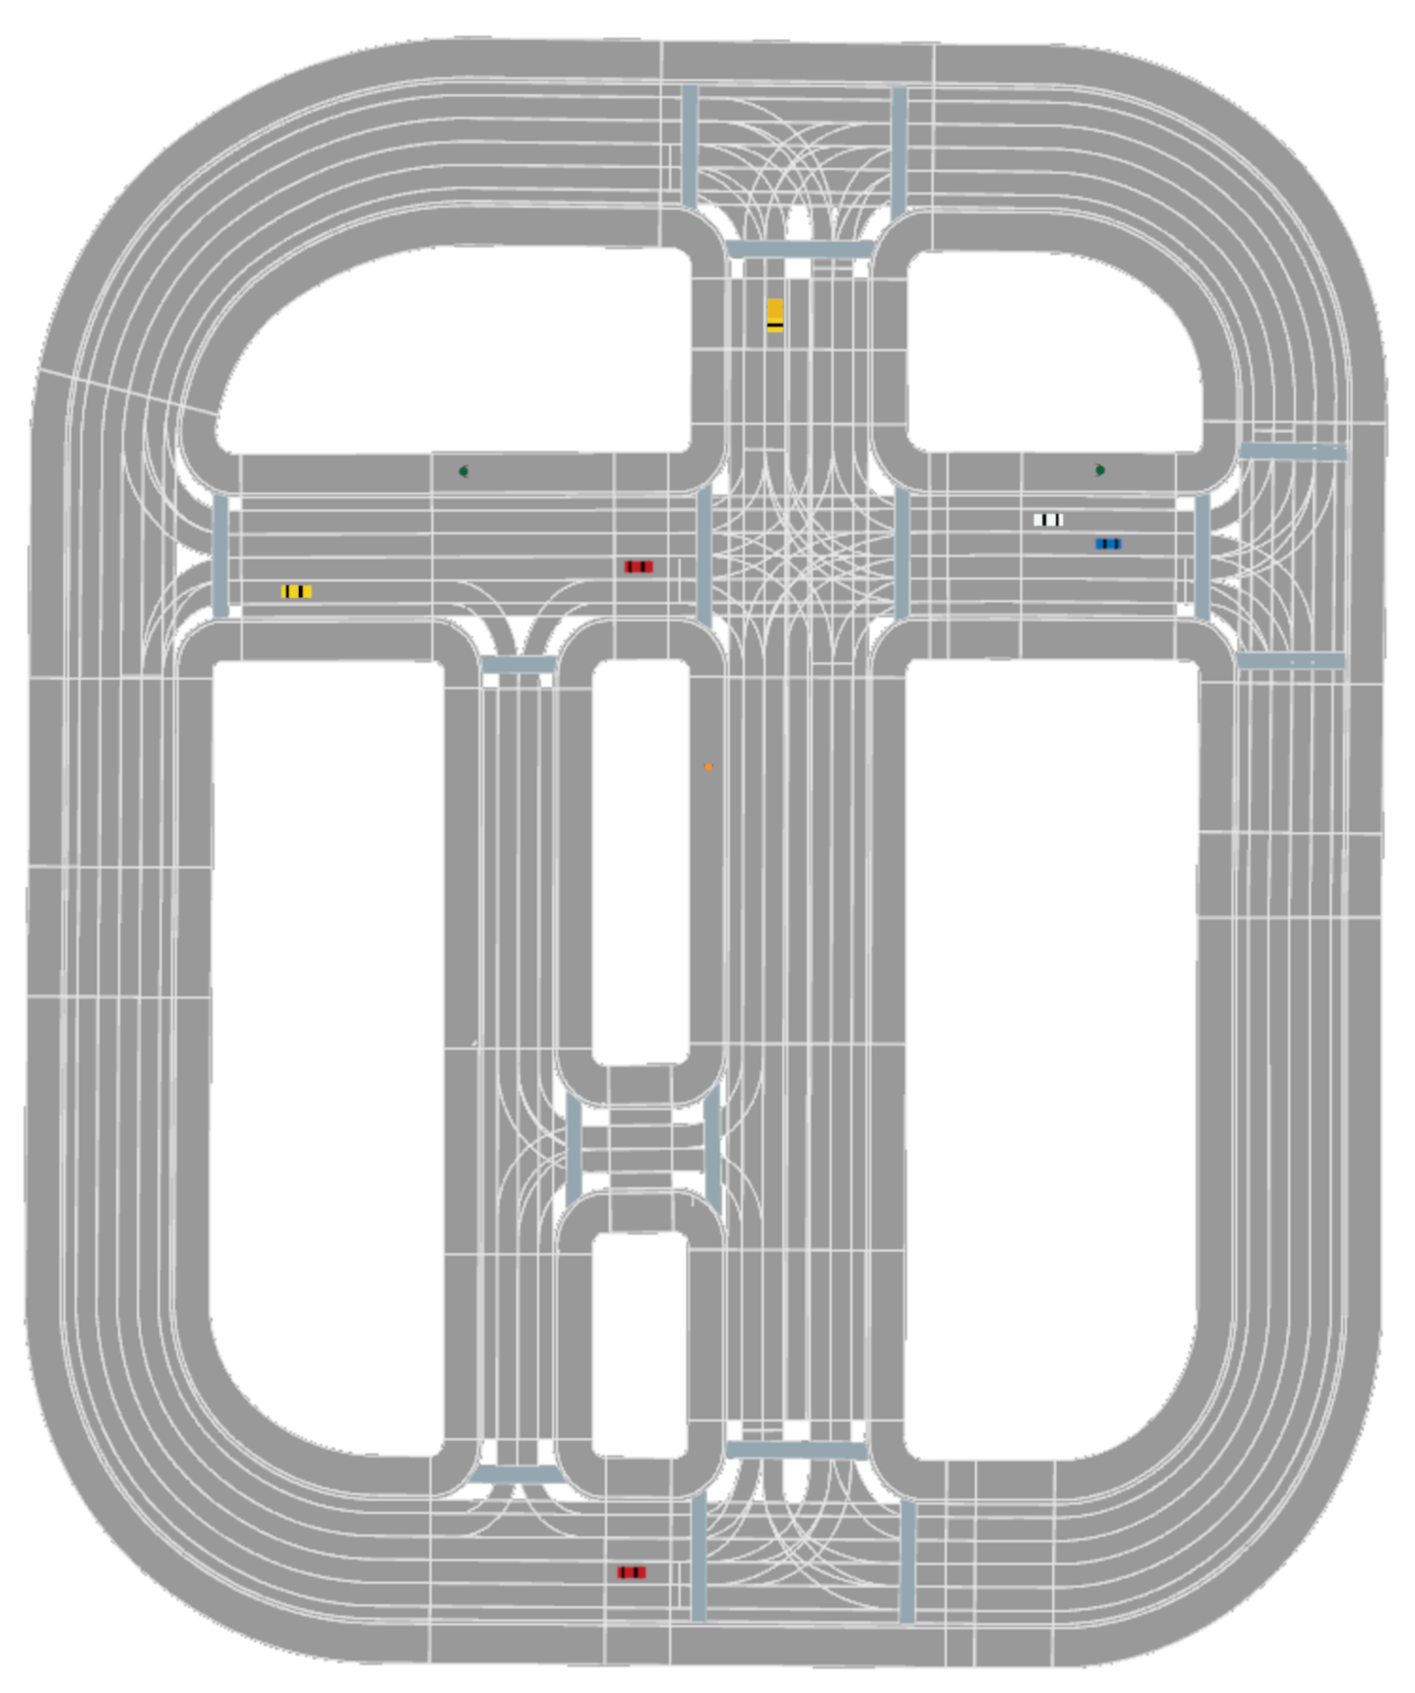
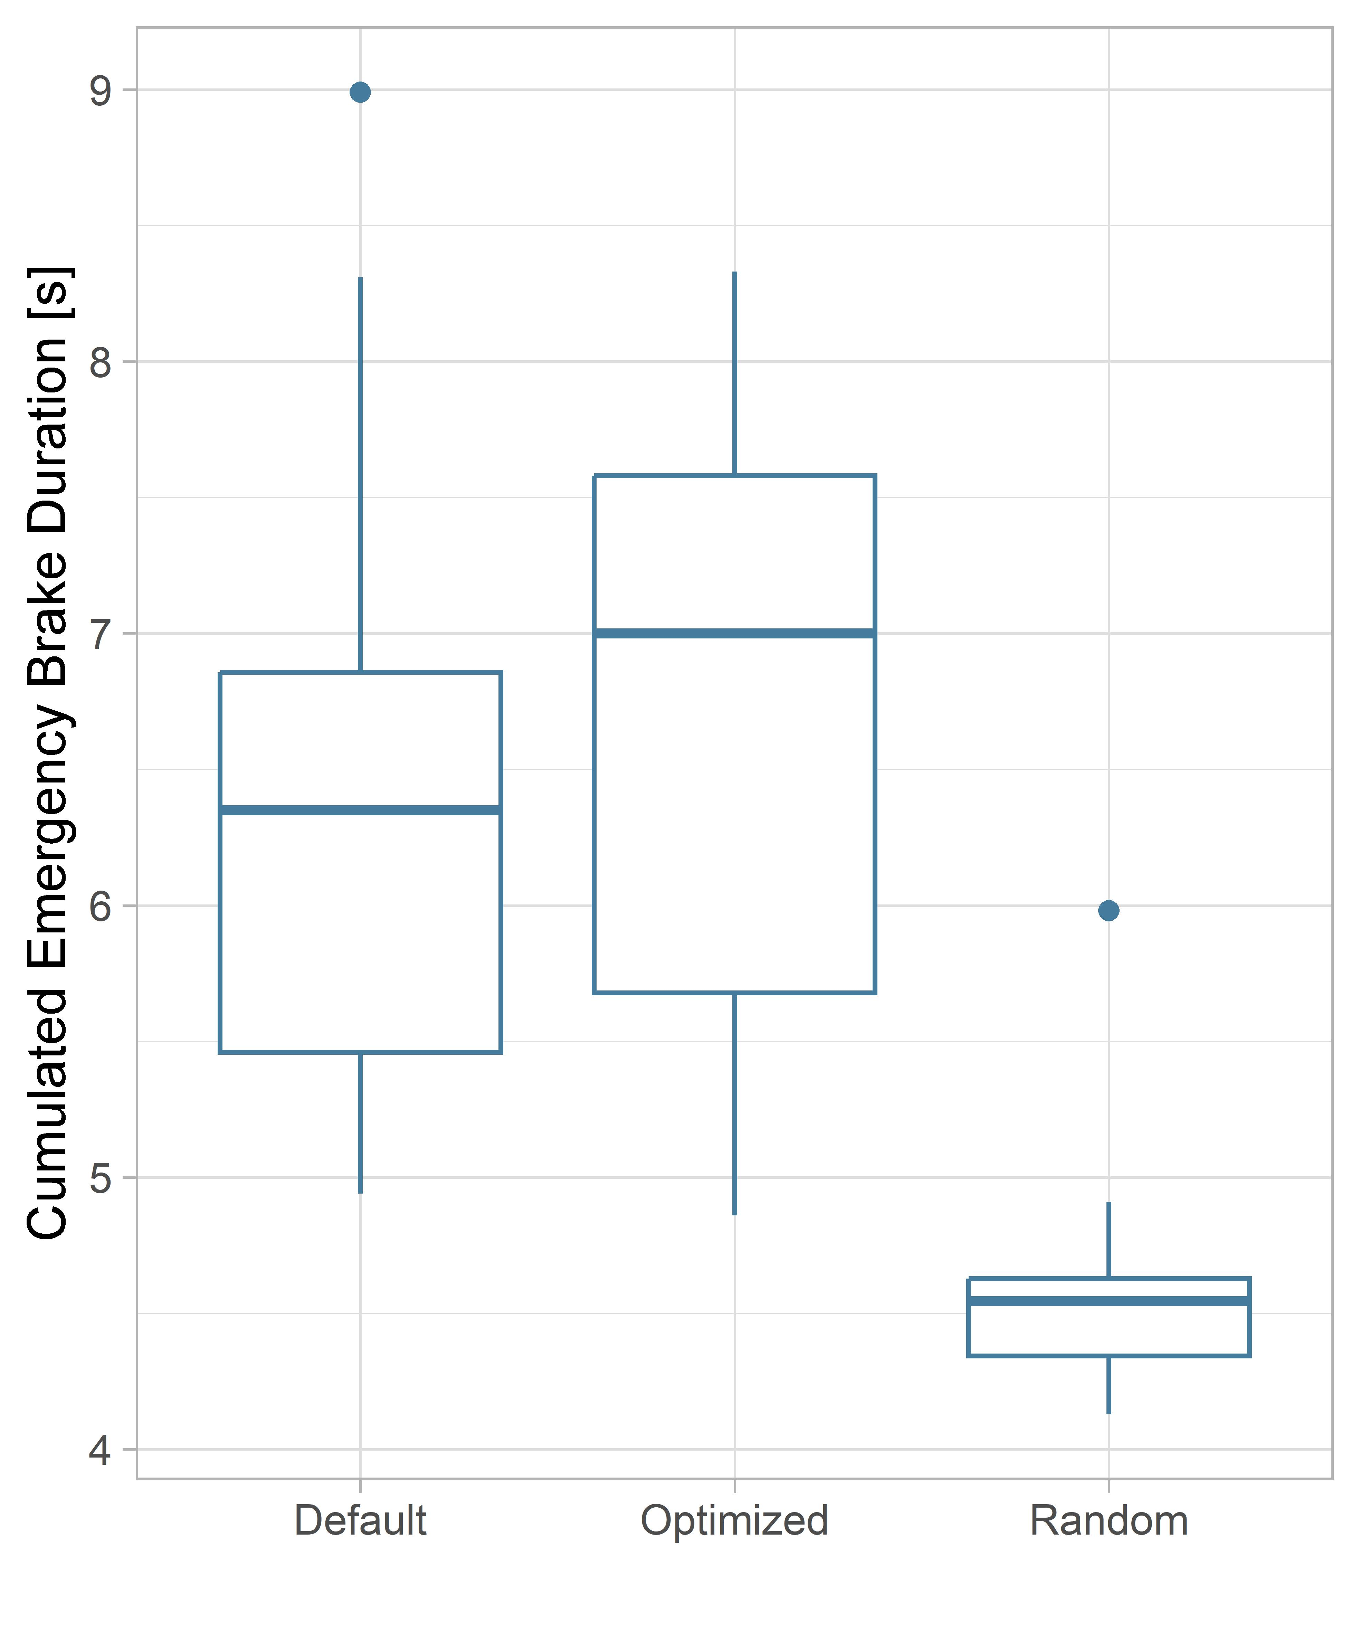
Evaluation: Start Scenario 2

Slide 13
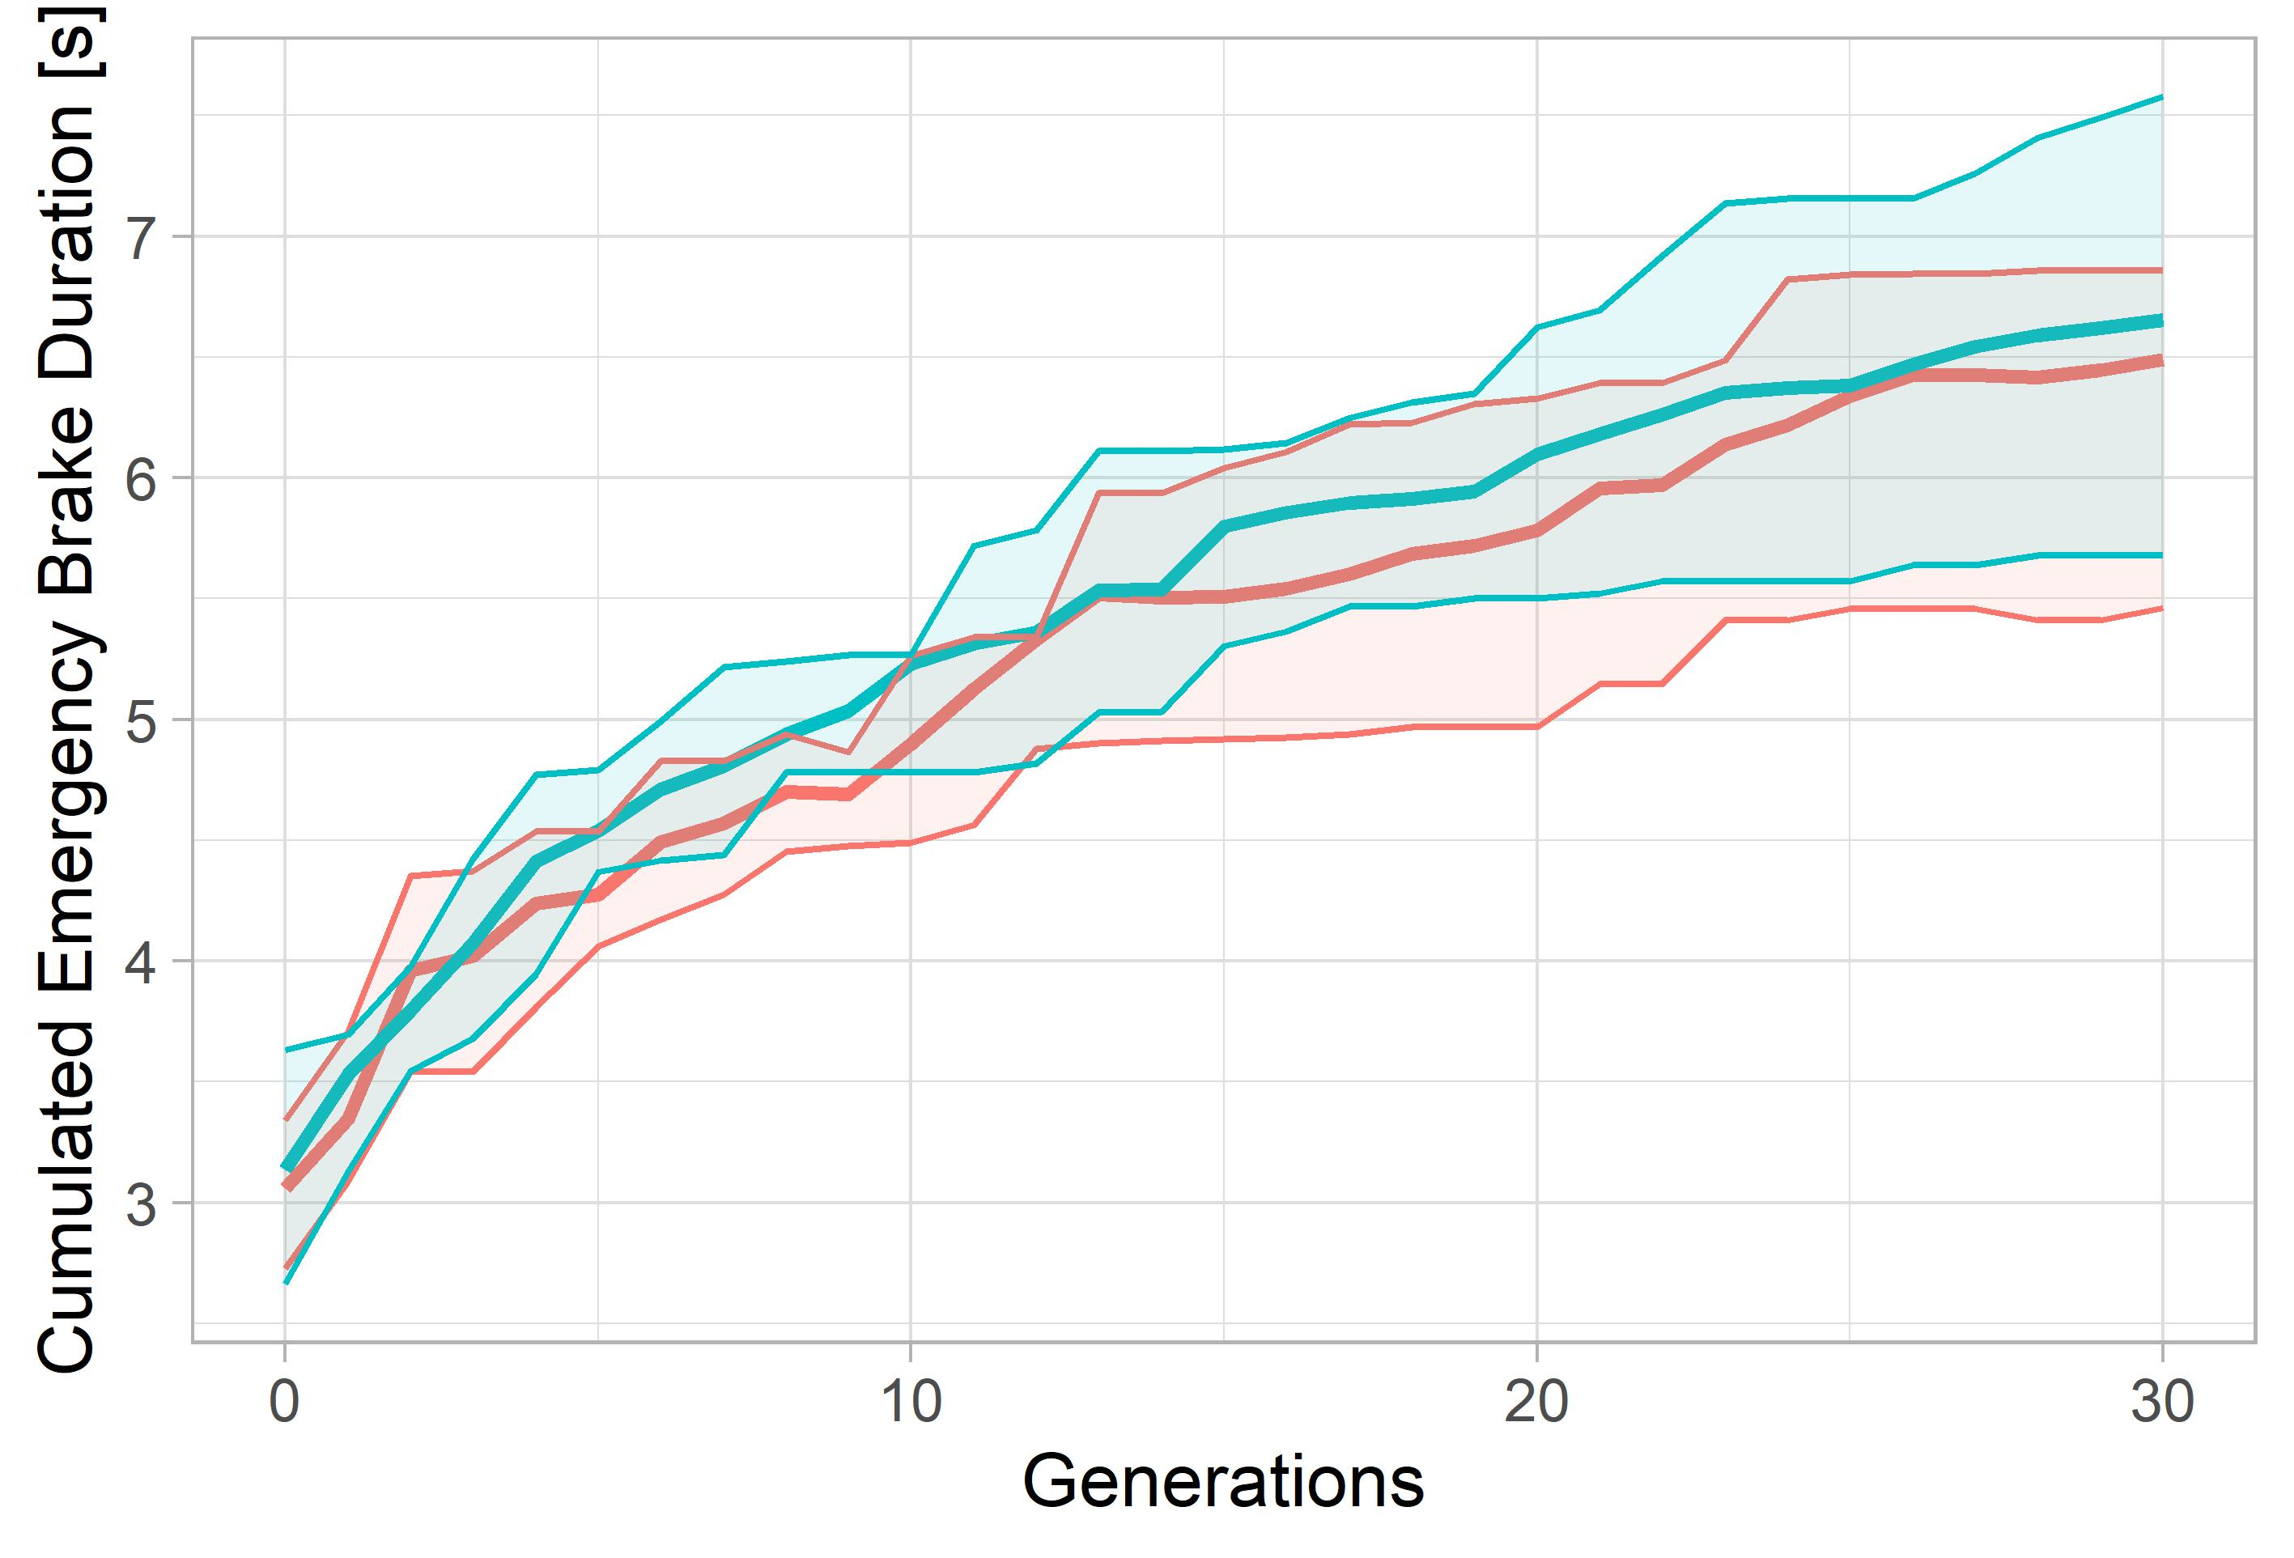
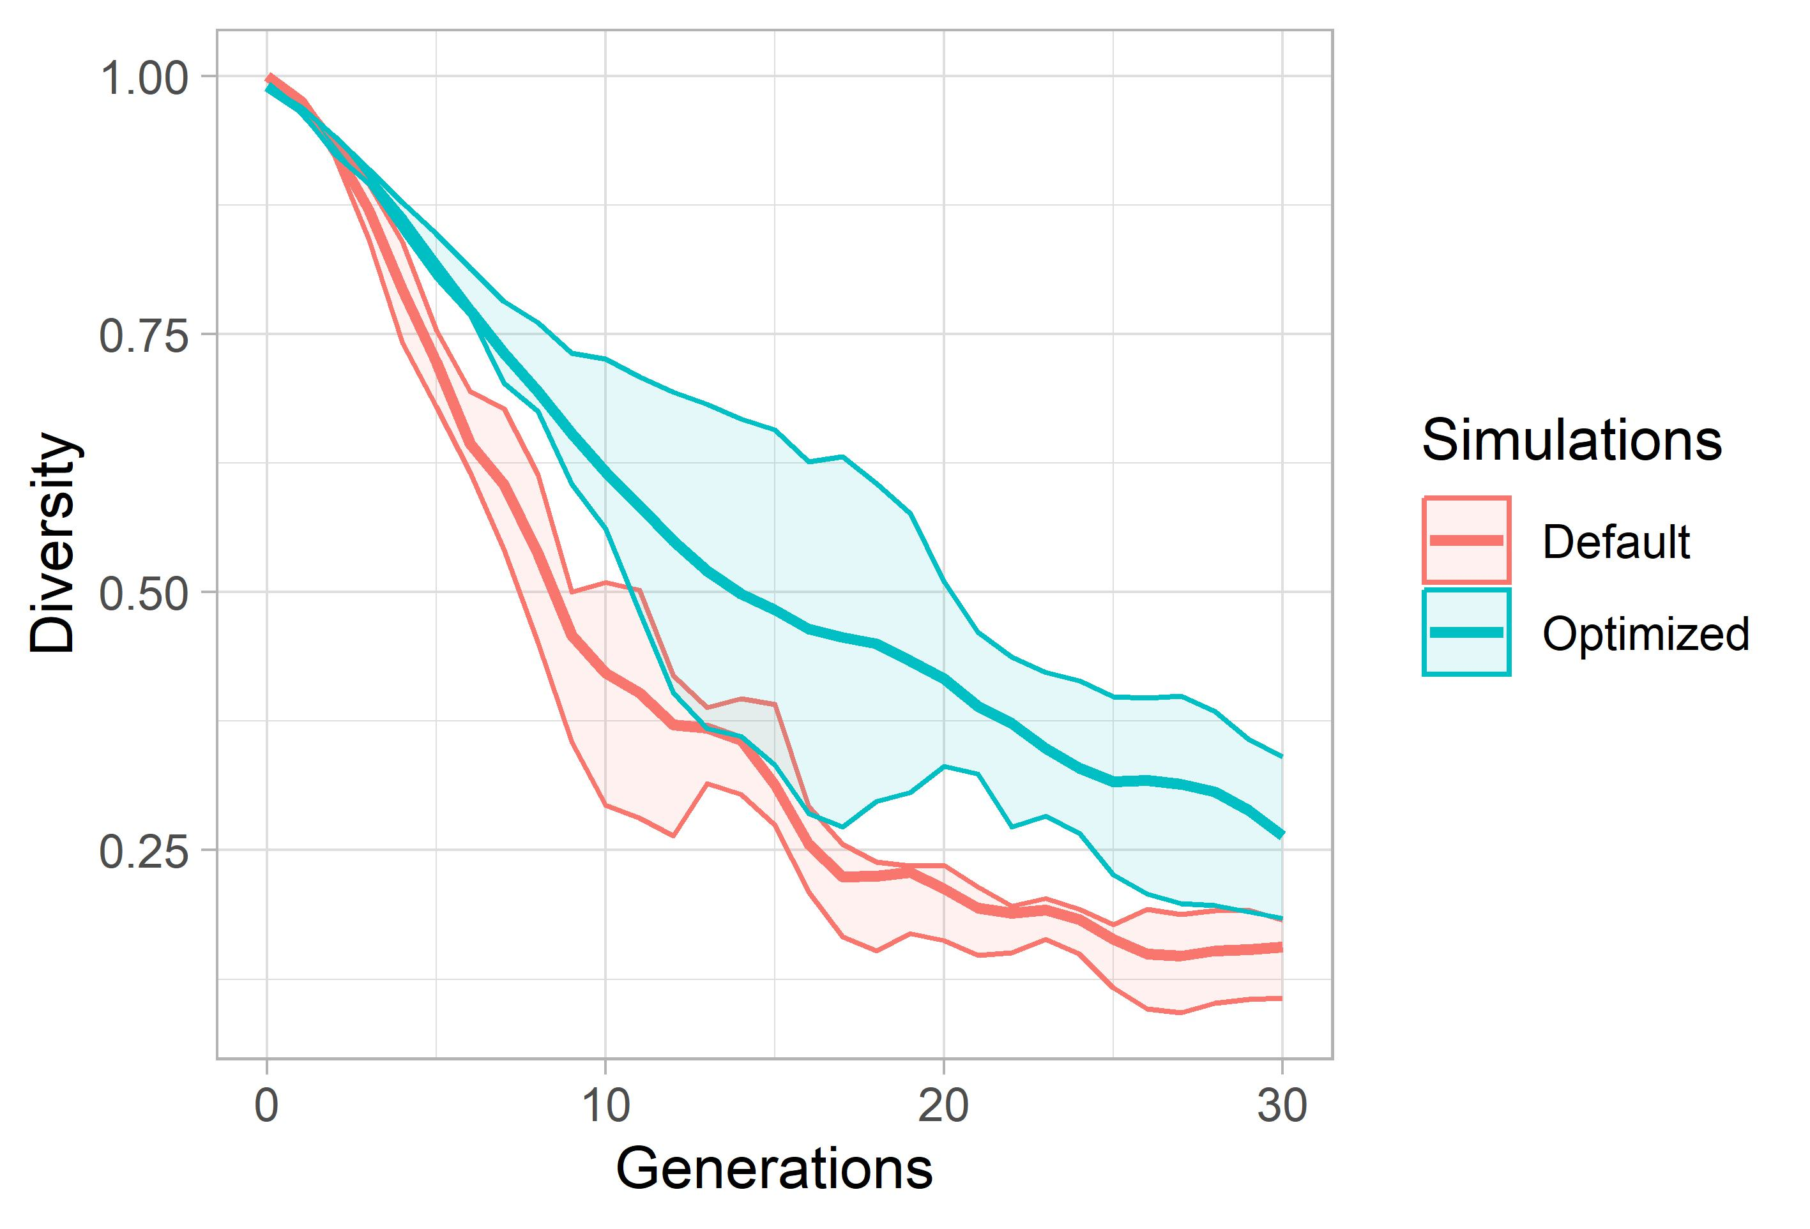
Evaluation: Start Scenario 2

Slide 14
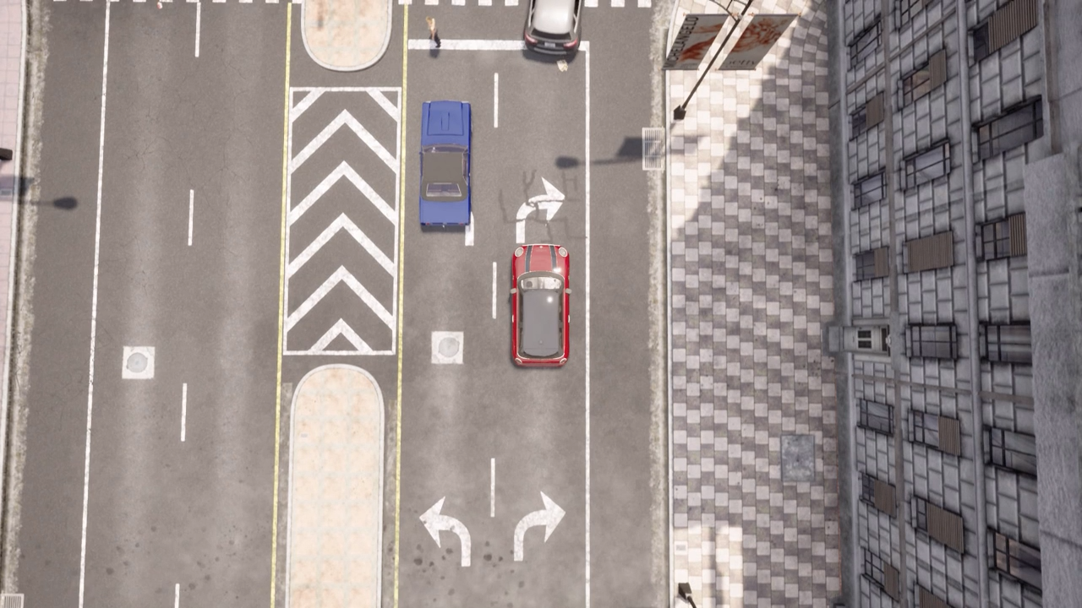
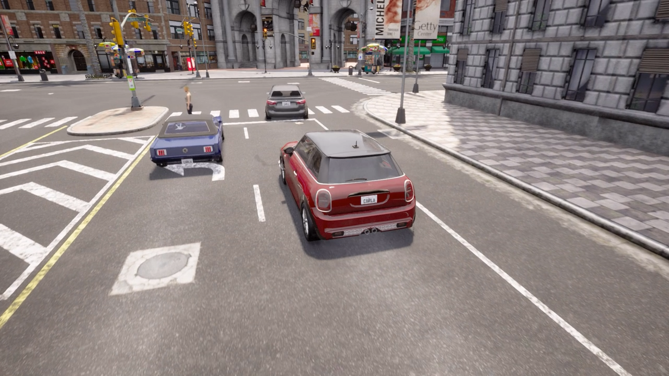
Critical Situation 1
After pedestrian crossing
NPC vehicle cuts shortly before junction and violates path of EGO vehicle
EGO vehicle has to emergency break

Slide 15
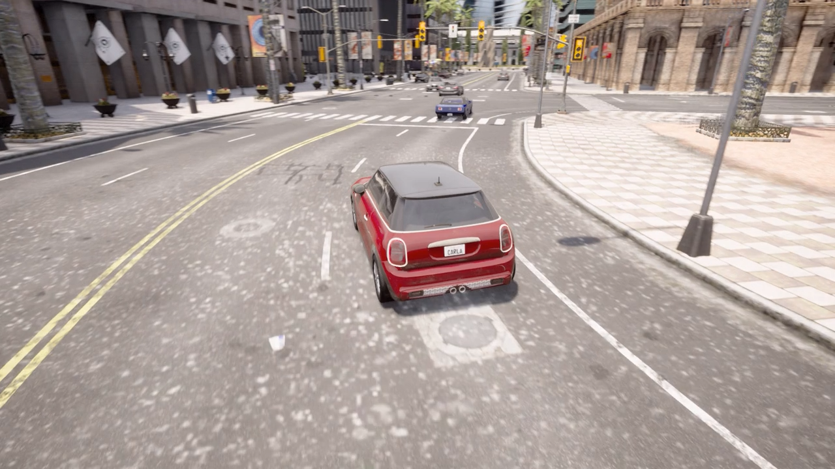
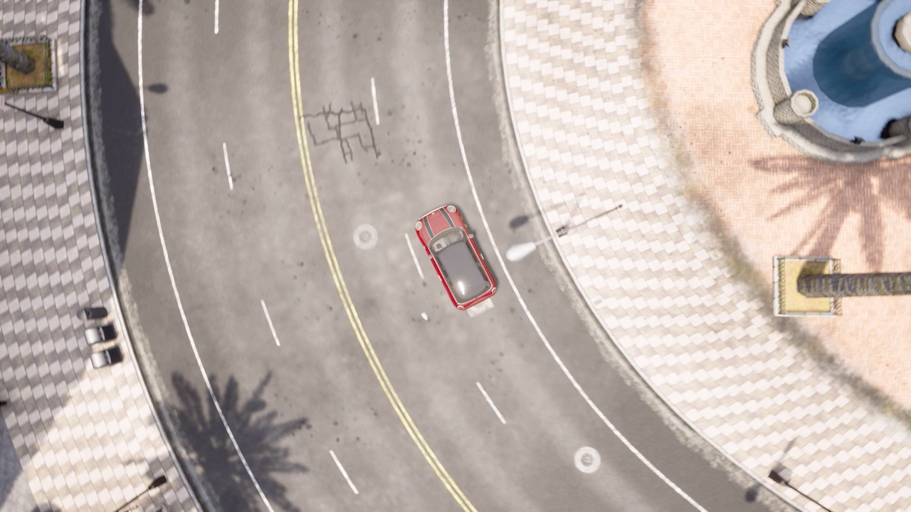
Critical Situation 2
Inside junction
NPC vehicle ignores right of way
EGO vehicle has to emergency break

Slide 16
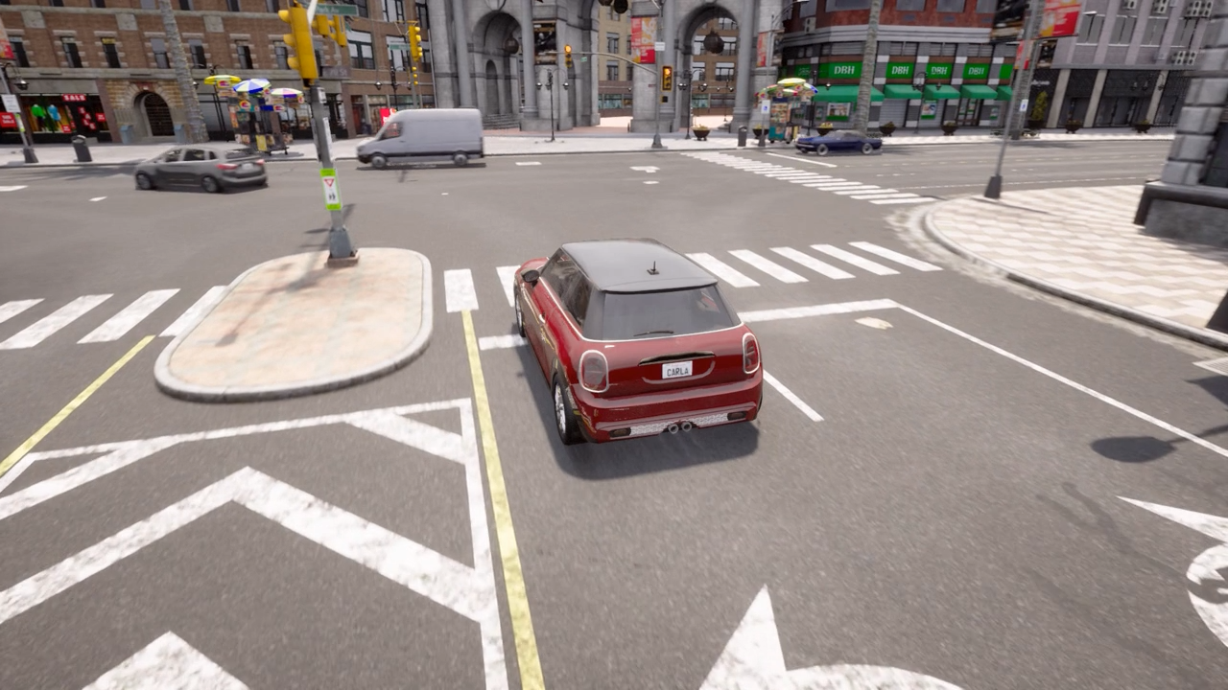
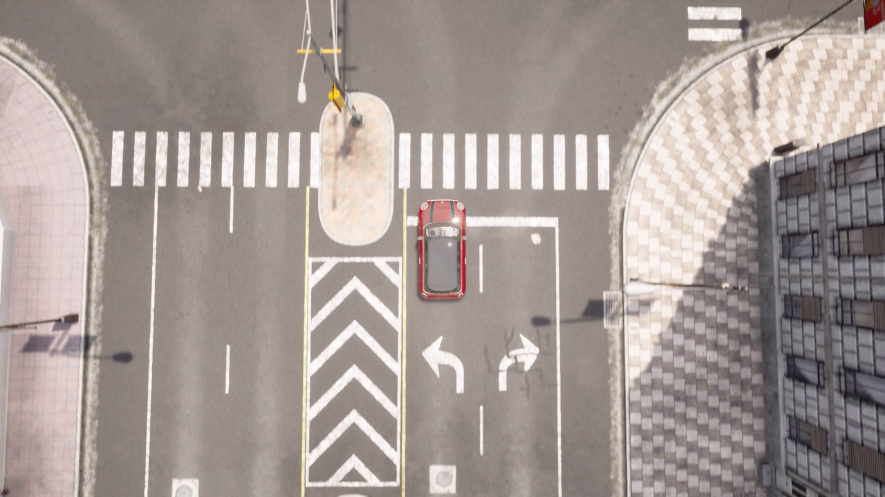
Critical Scenario 3
Kid runs over road
Kid is occluded by Truck
EGO vehicle (blue) has to emergency break

Slide 17
Thank You!

